Slide 1
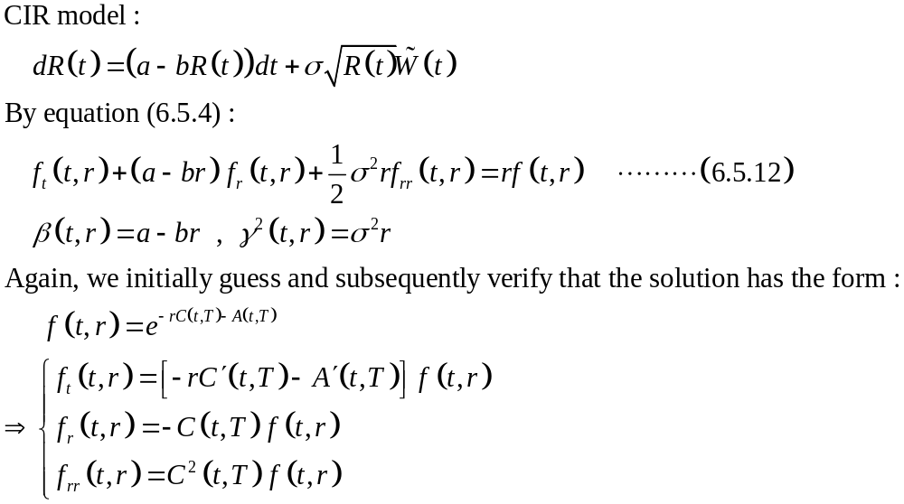
Example 6.5.2 CIR interest rate model

Slide 2
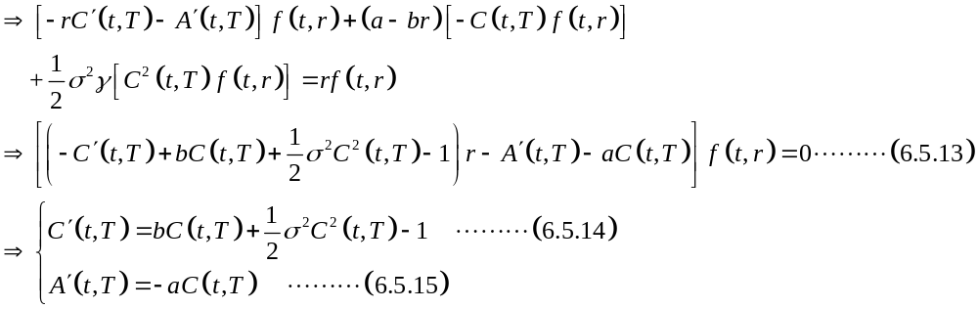
CIR interest rate model (continue 1)

Slide 3
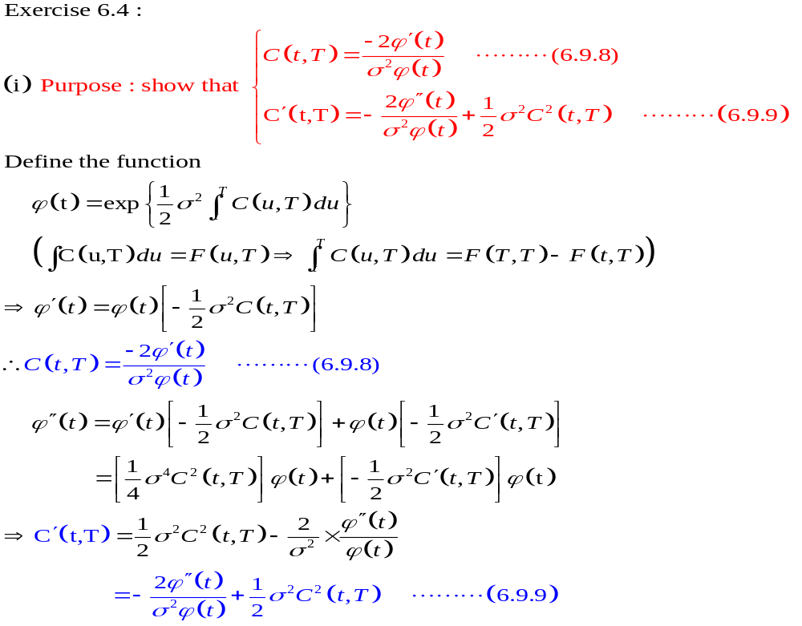
CIR interest rate model (continue 2)

Slide 4
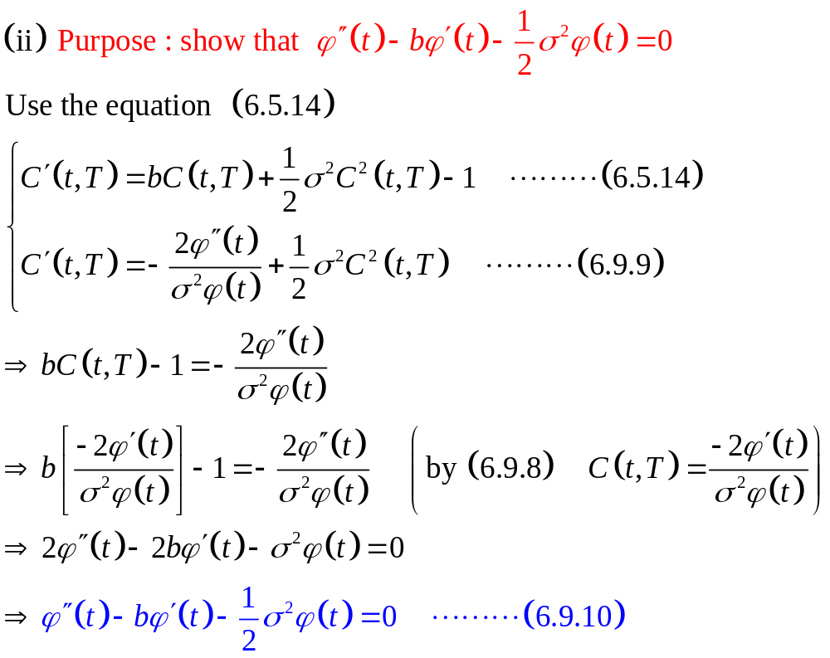
CIR interest rate model (continue 3)

Slide 5
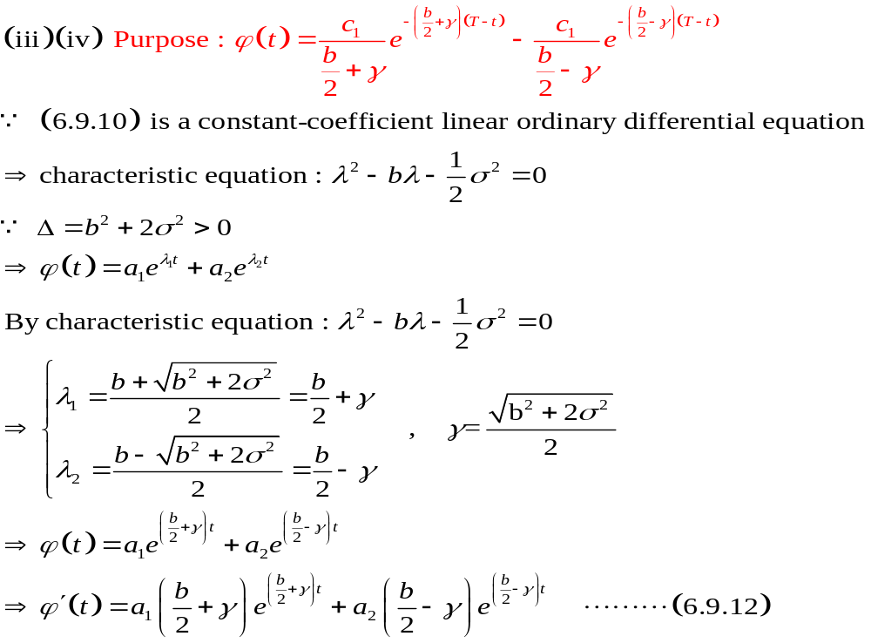
CIR interest rate model (continue 4)

Slide 6
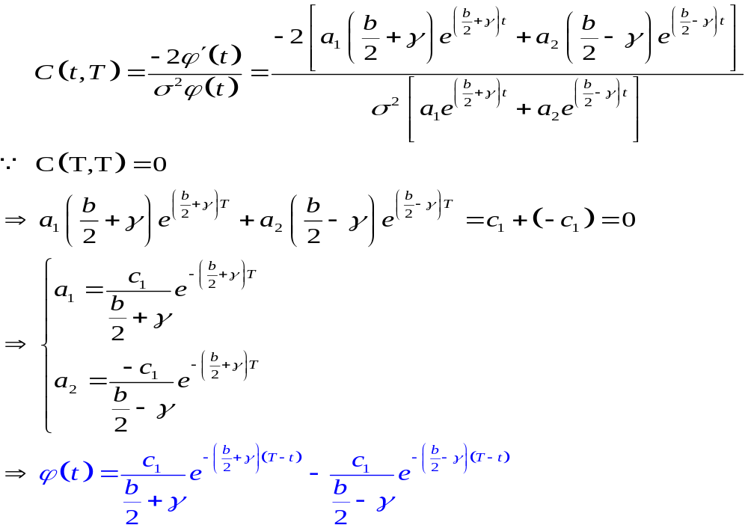
CIR interest rate model (continue)

Slide 7
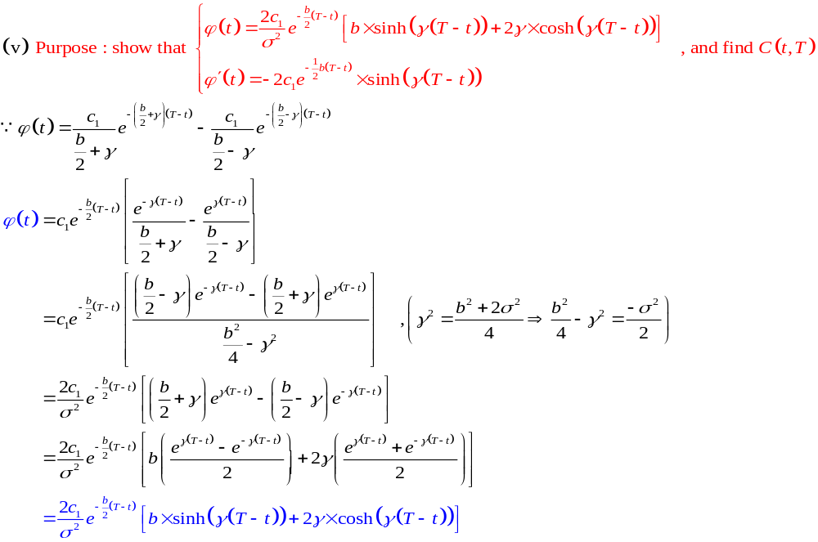
CIR interest rate model (continue)

Slide 8
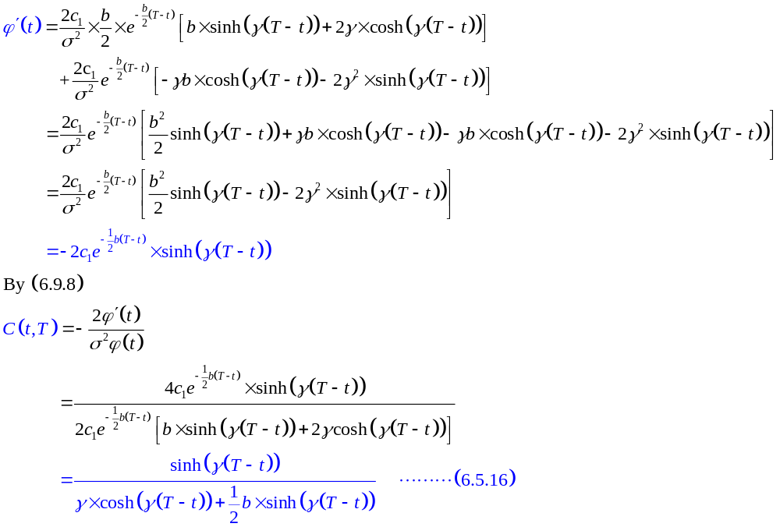
CIR interest rate model (continue)

Slide 9
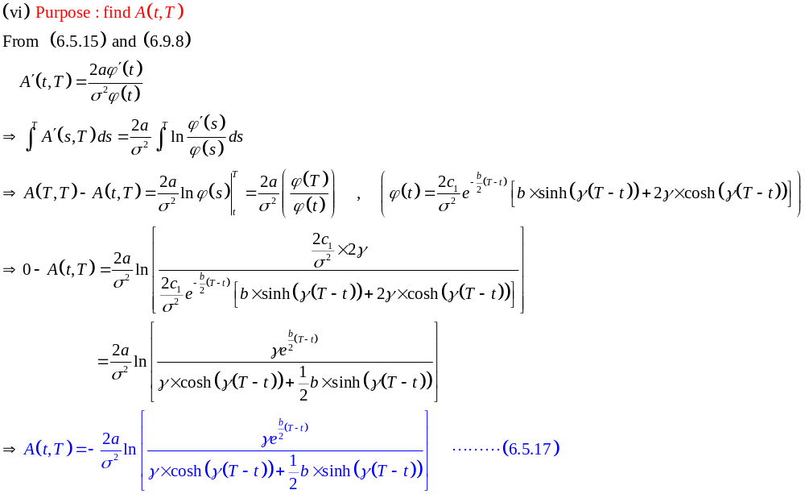
CIR interest rate model (continue)

Slide 10
Example 6.5.3 Option on a bond
Consider the general short-rate model (6.5.1).
Let 0≦t ≦T₁<T₂ be given. In this example, the fixed time T₂ is the maturity date for a zero-coupon bond. The fixed time T₁ is the expiration date for a European call on this bond. We wish to determine the value of this call at time t.
Suppose we have solved for the function f(t,r) satisfying (6.5.4) together with the terminal condition (6.5.5). This gives us the price of the zero-coupon bond as a function of the underlying interest rate.

Slide 11
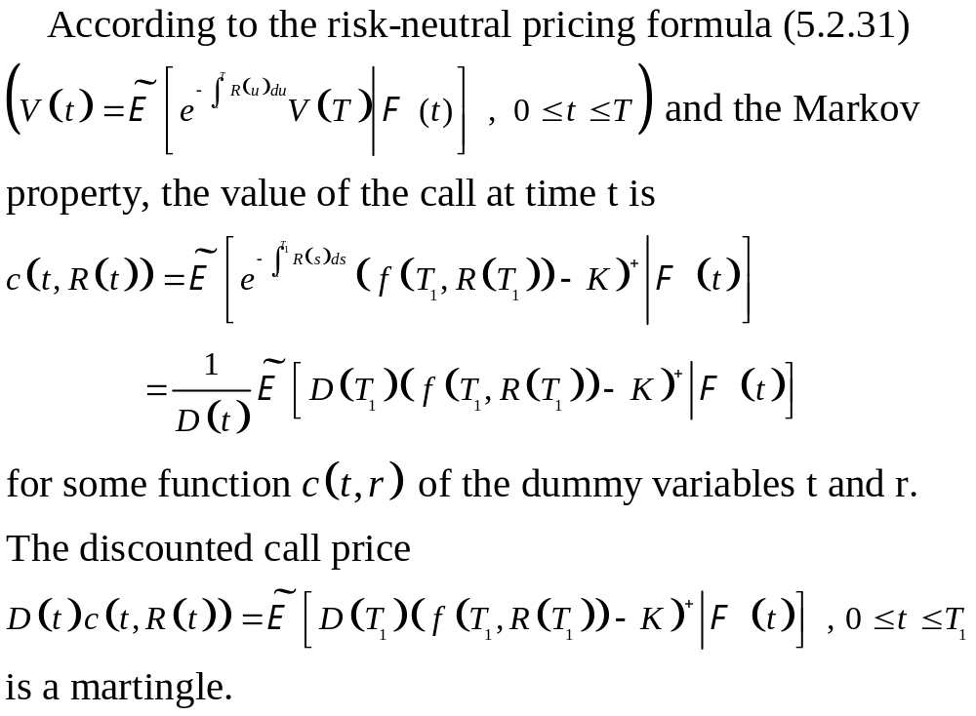
Option on a bond (continue)

Slide 12
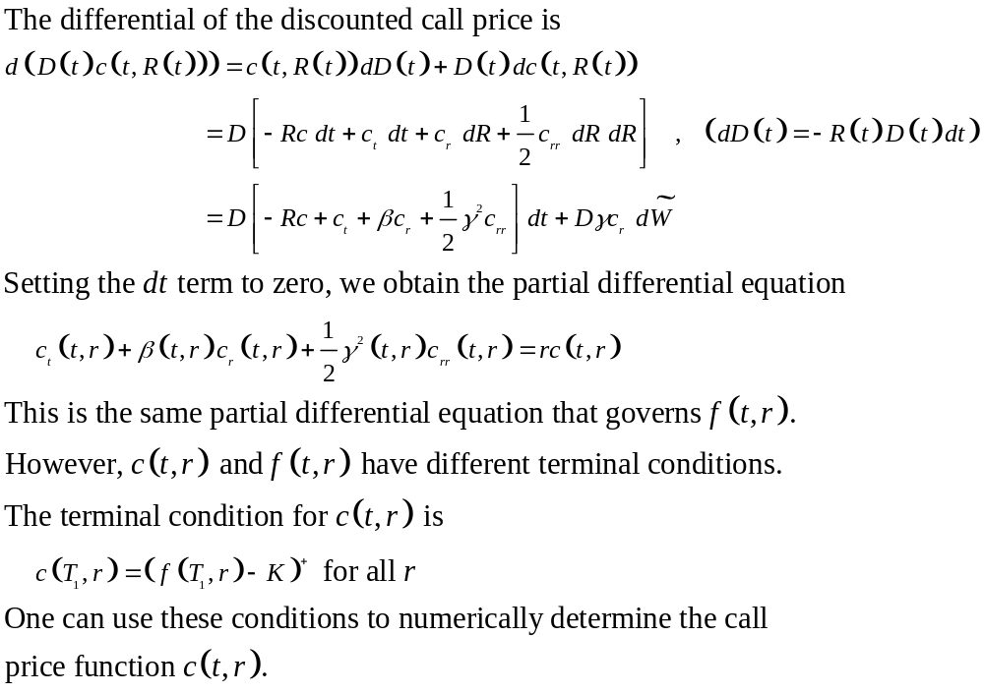
Option on a bond (continue)

